Slide 1




NEW
WARE
Nihad Maharramov (INHA IT-3)
01

Slide 2

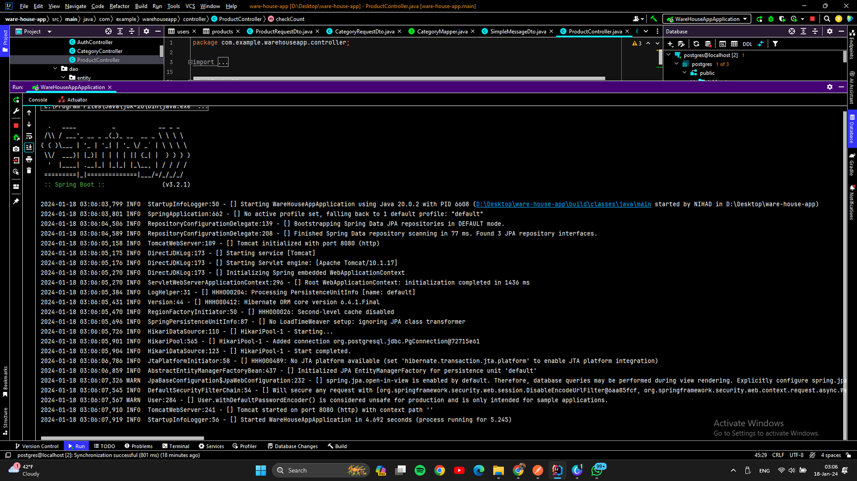
WORKS
Project works correctly

Slide 3
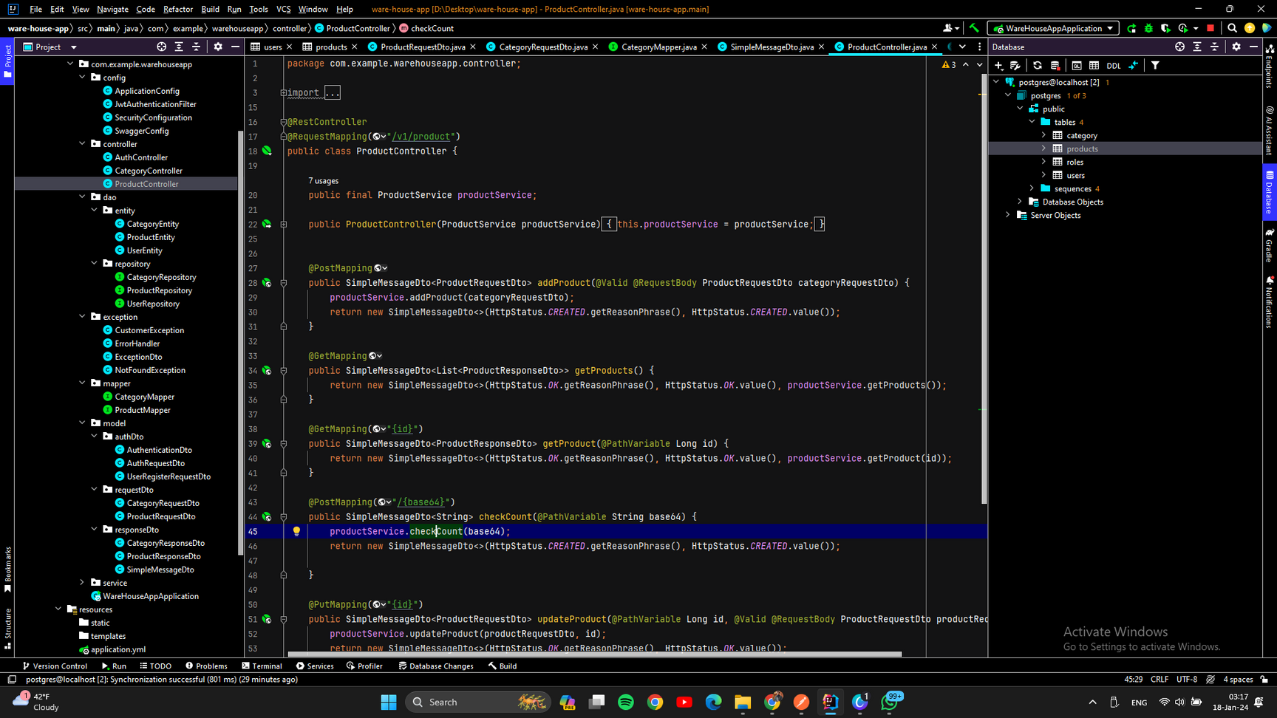
2. CLEAN STRUCTURE

Slide 4

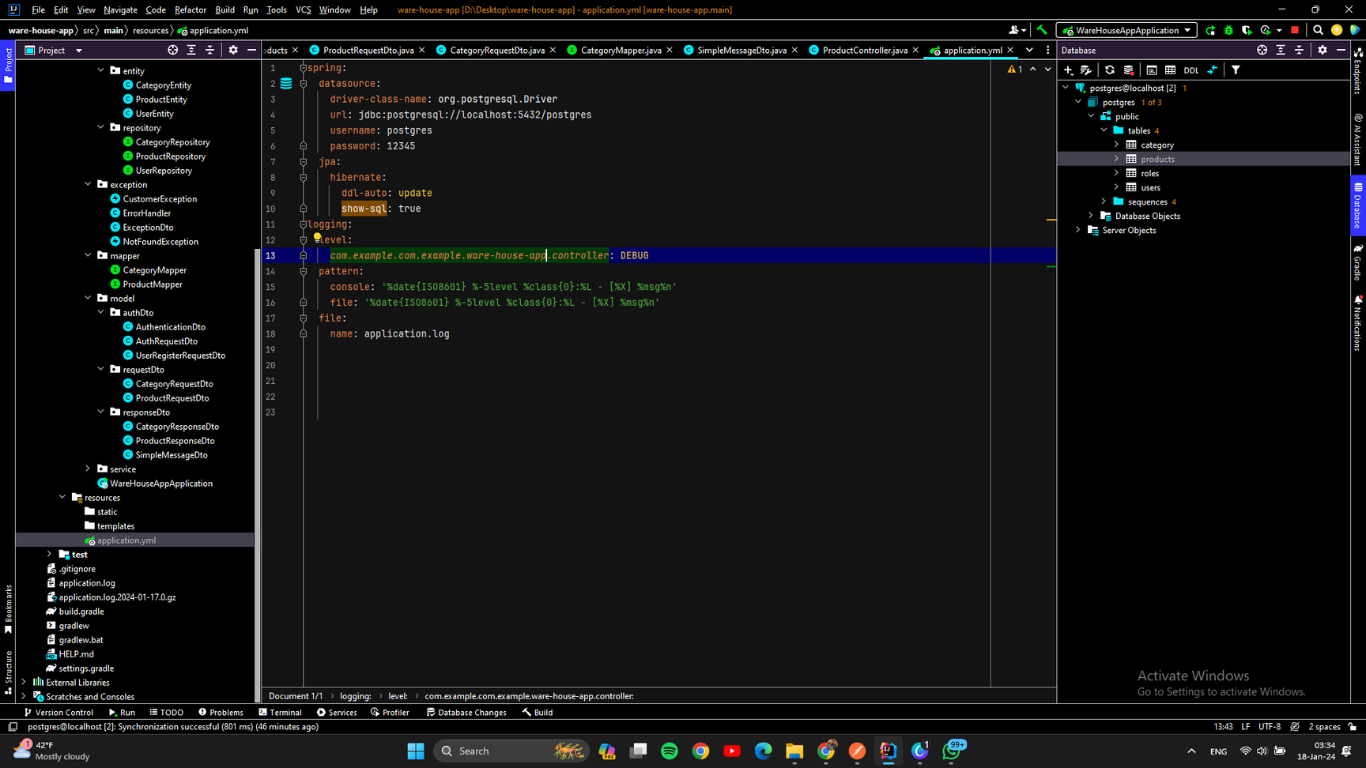
3. DB CONNECTIONS

Slide 5
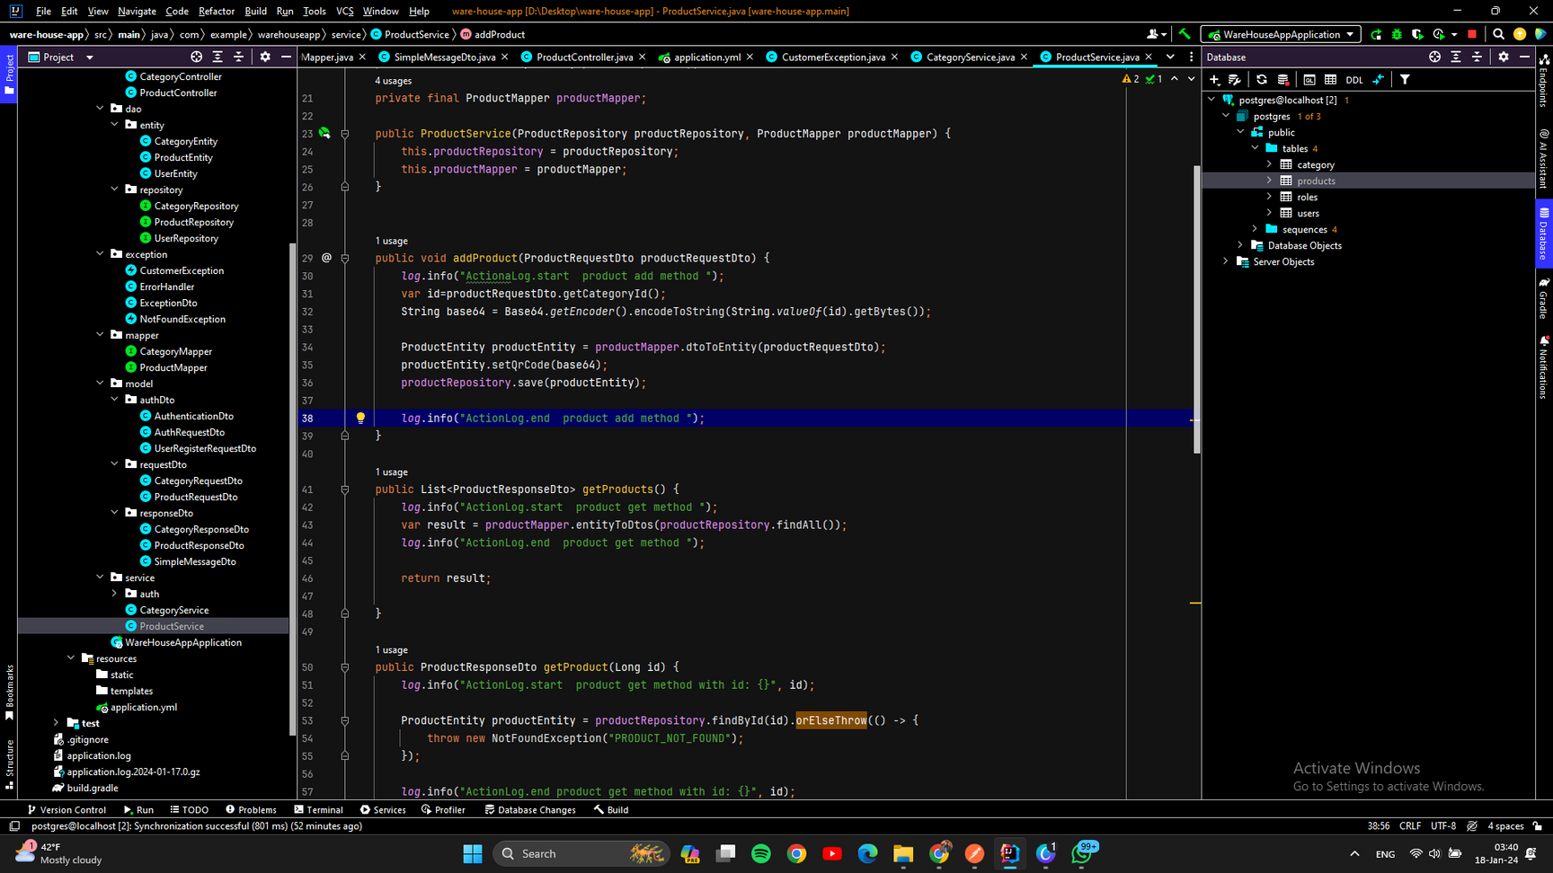
4.CRUD
Create, Read, Update, Delete

Slide 6
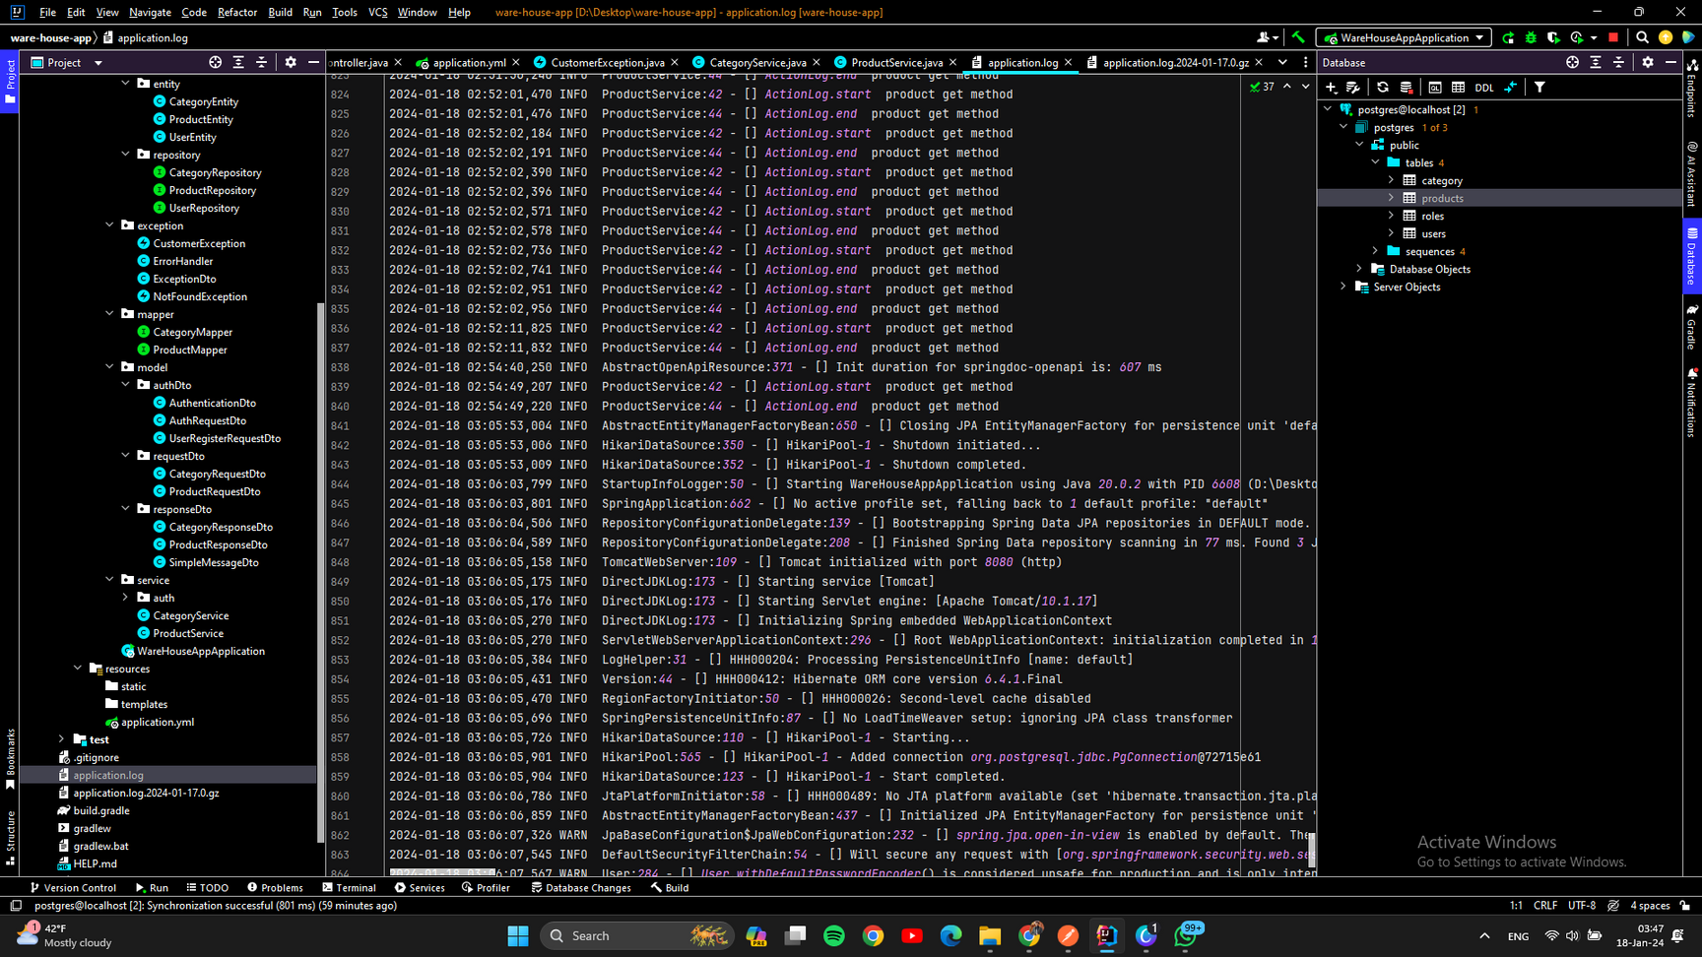
5. Logging
application.log

Slide 7
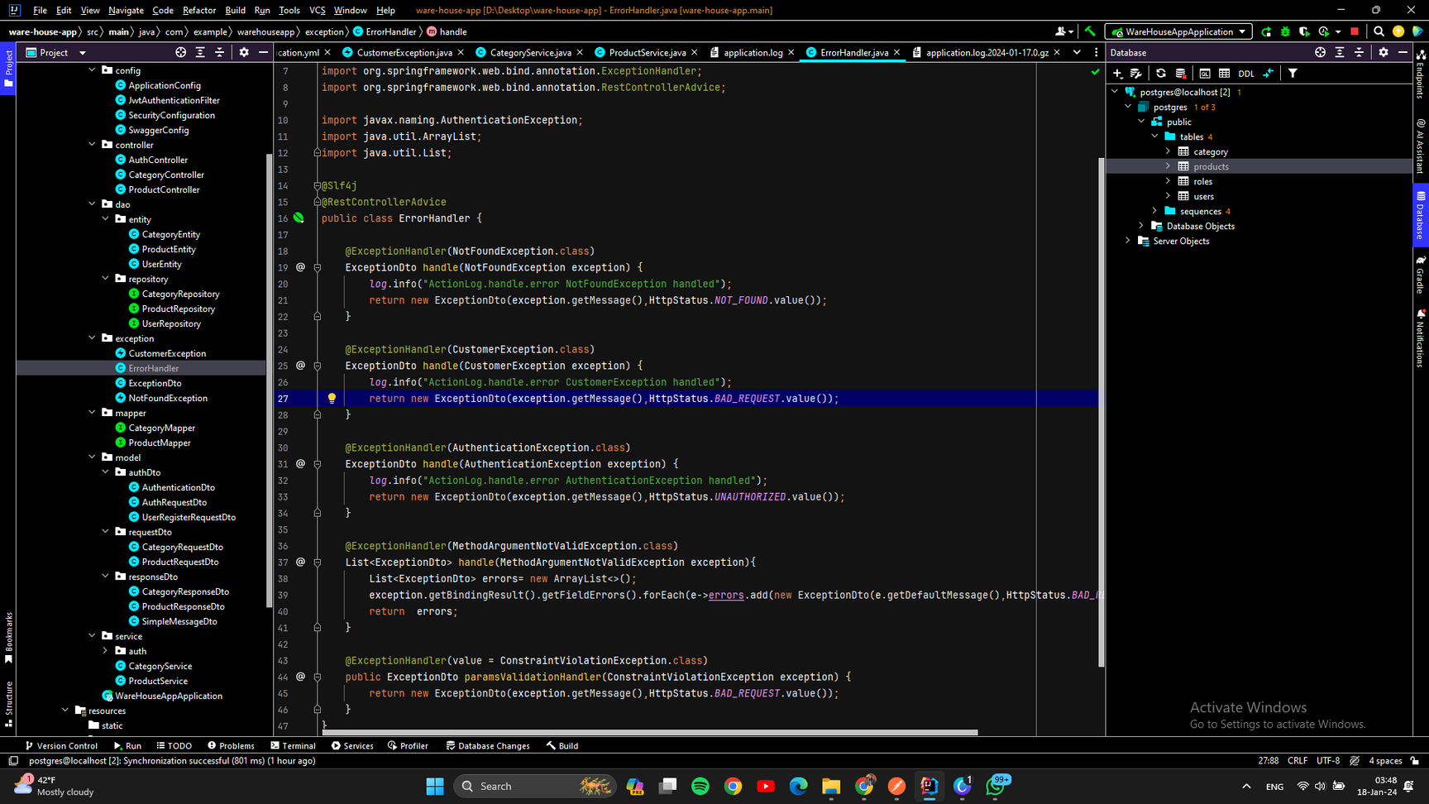
6. ERROR HANDLING

Slide 8
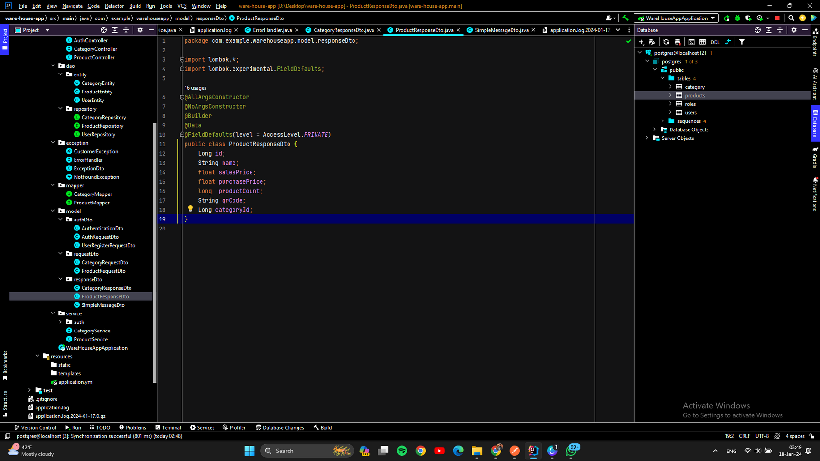
7. STRUCTURED RESPONSE
Create, Read, Update, Delete

Slide 9
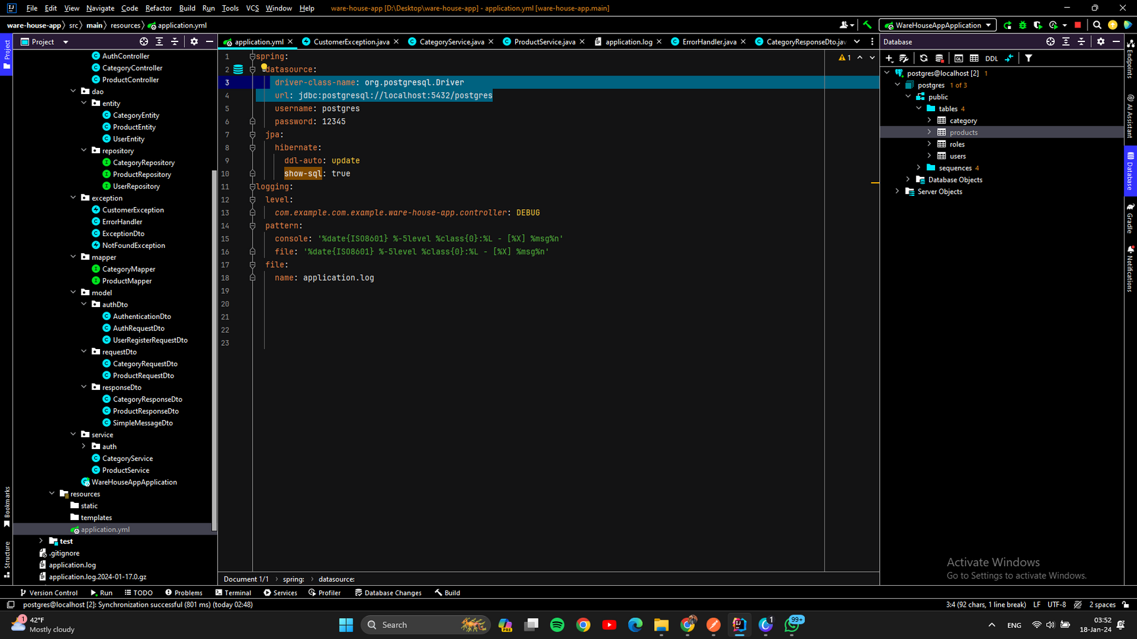
8. CUSTOM ADDRESS/PORT

Slide 10
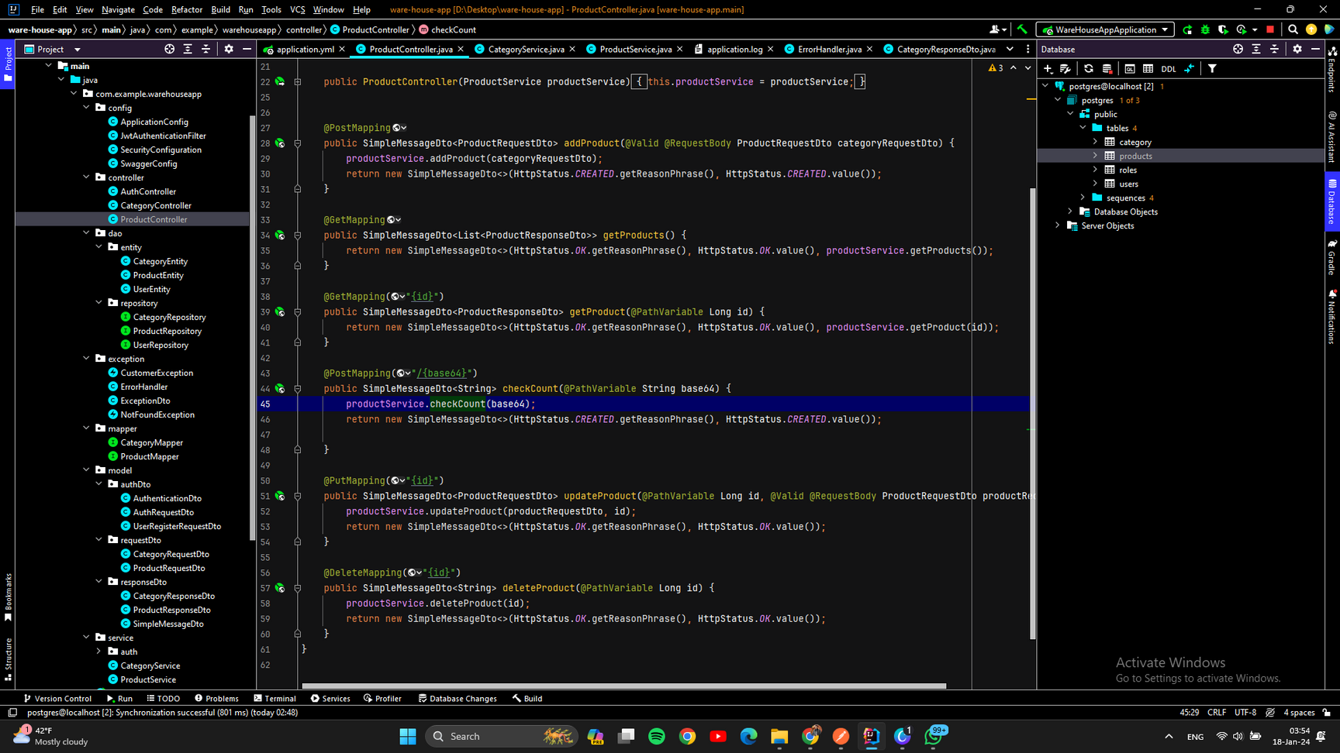
9. USING METHODS
GET/POST/PUT/DELETE

Slide 11
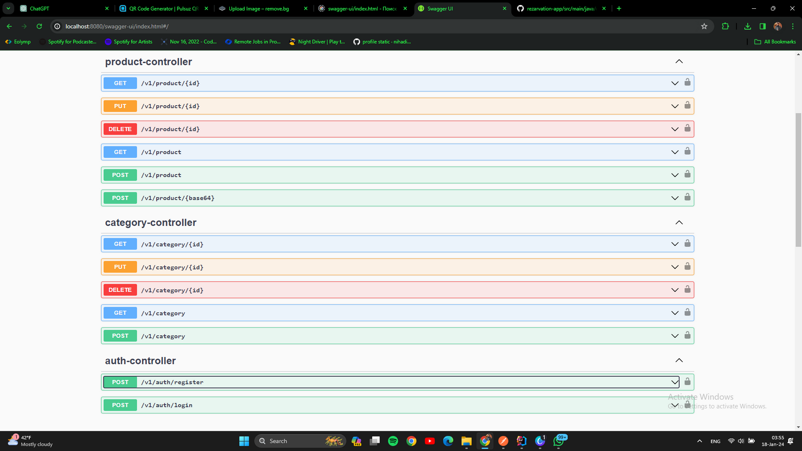
10. SWAGGER
UI

Slide 12
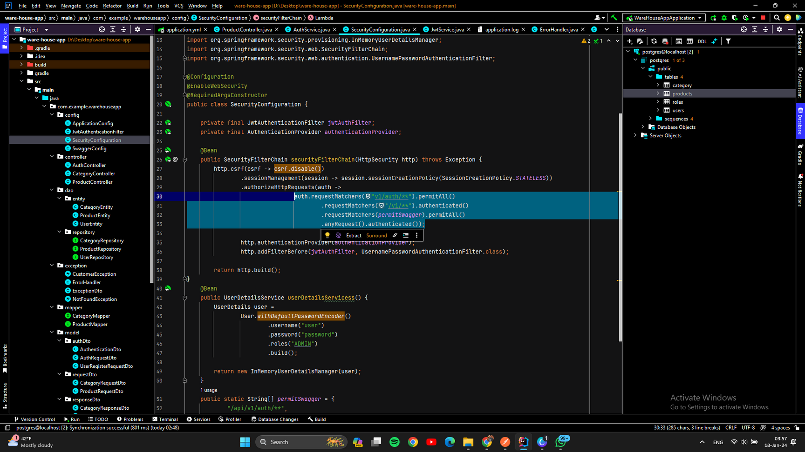
11. SECURITY

Slide 13

12. PRESENTATION

Slide 14
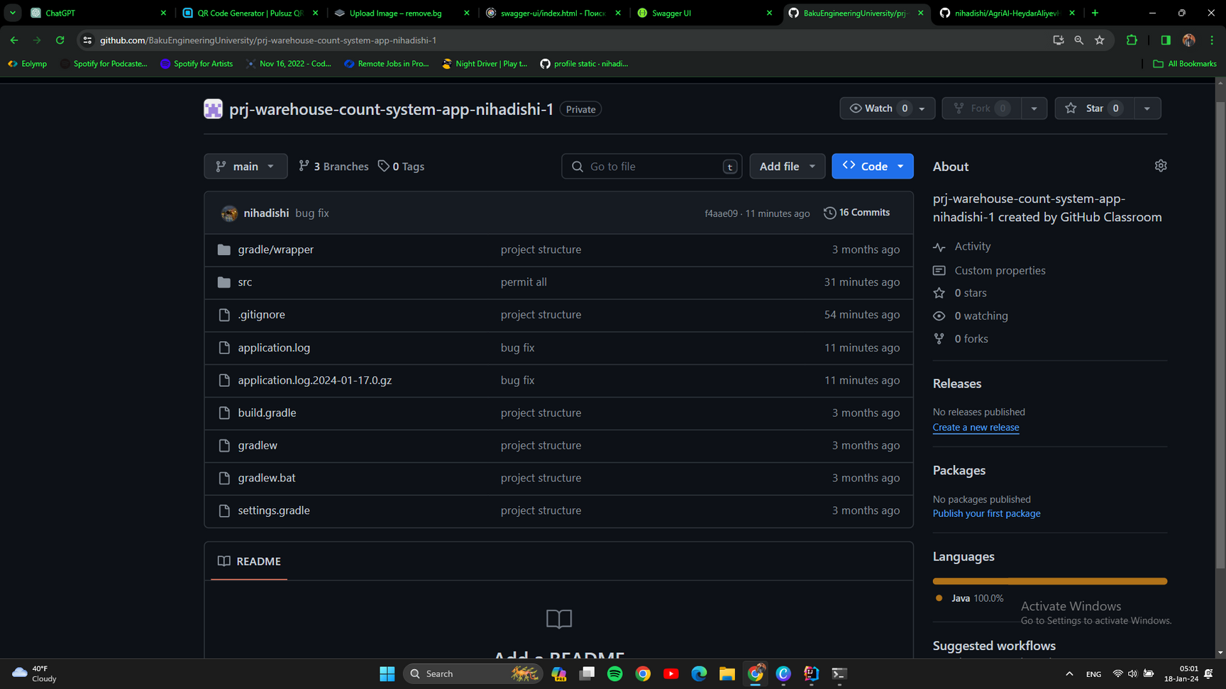
13. GIT COMMITS

Slide 15
PHONE
I'm ready to work with you!
077-637-38-38
EMAIL
nmeherremov1@std.beu.edu.az
Thank you!
WEBSITE
www.nihadishi.vercel.app

